Slide 1


Day 6: Managing Breakdown Categories and Subitems
Manage Breakdown Categories and Sub items

Slide 2

Break Down Category
Breakdown Category (BDC) is used to control subitem and other sub-assignments for transactional data.
There are two subitem catagories:
1: Consolidation transaction types are for balance sheet items and include opening balance, incoming unit, and net variation for example.
2: Functional areas are for income statement items and include sales, revenue, marketing, and consulting for example.
BDCs play an important role in reporting for example:
Balance sheet items can be broken down by consolidation transaction type.
Income statement values can be reported in detail by item or at a higher level by functional area.

Slide 3
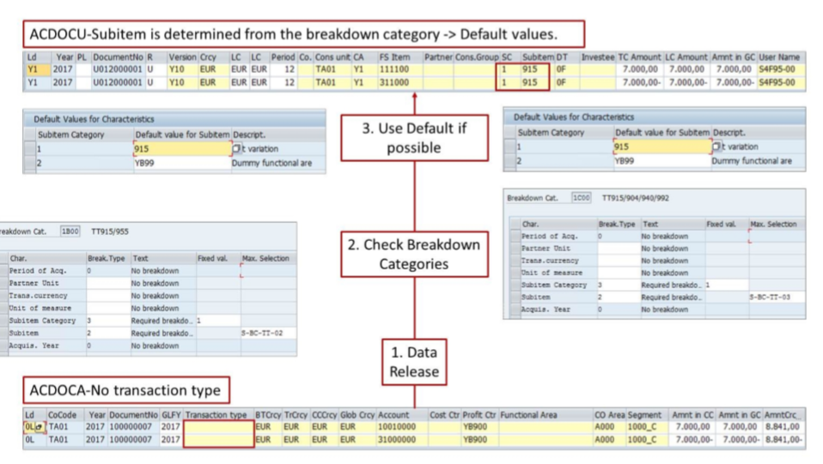

Slide 4
Blank: The associated items can not be sub-classified by the sub-assignments. Same as type O
O No Breakdown: The associated items can not be sub-classified by the sub-assignments. Same as the blank type.
1: Optional Breakdown: Initialized value allowed: The associated items can be sub-classified by the sub – assignments or it can be left blank. (initialized)
2: Required breakdown: If blank, the default value is used: The default value is automatically used if the field is left blank in the source data.
3: Required breakdown: Entry is Forced, default allowed: The associated items must be sub-classified by the subsegments, and the default value can be used.
4: Required breakdown: Entry is Forced, default not allowed: The associated items must be sub-classified by the sub assignments, and the default value can not be used.

Slide 5
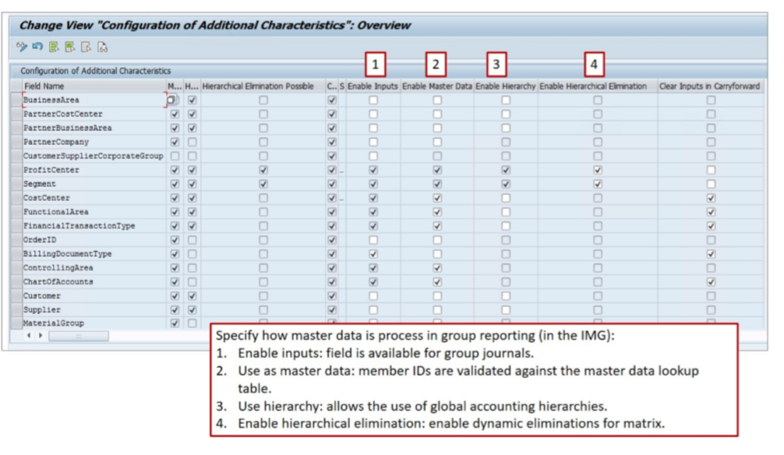
Additional Characteristics ( Master Data)

